Slide 1
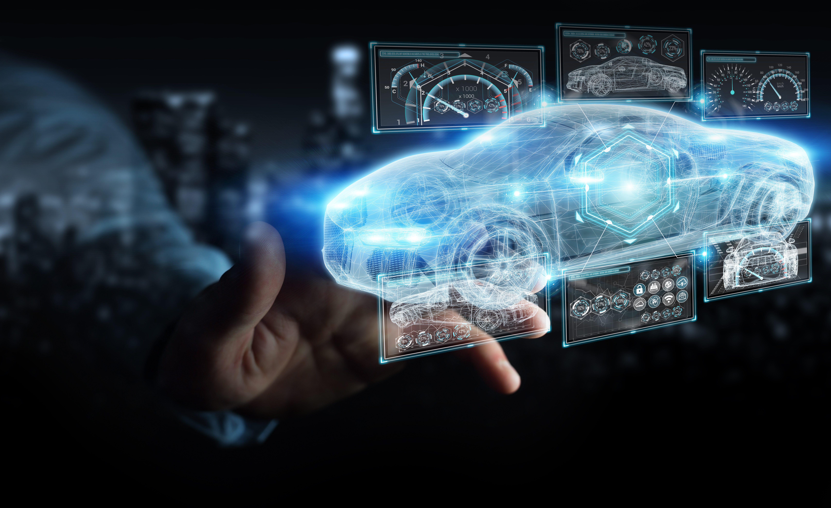


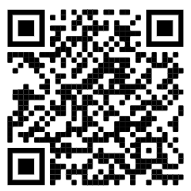
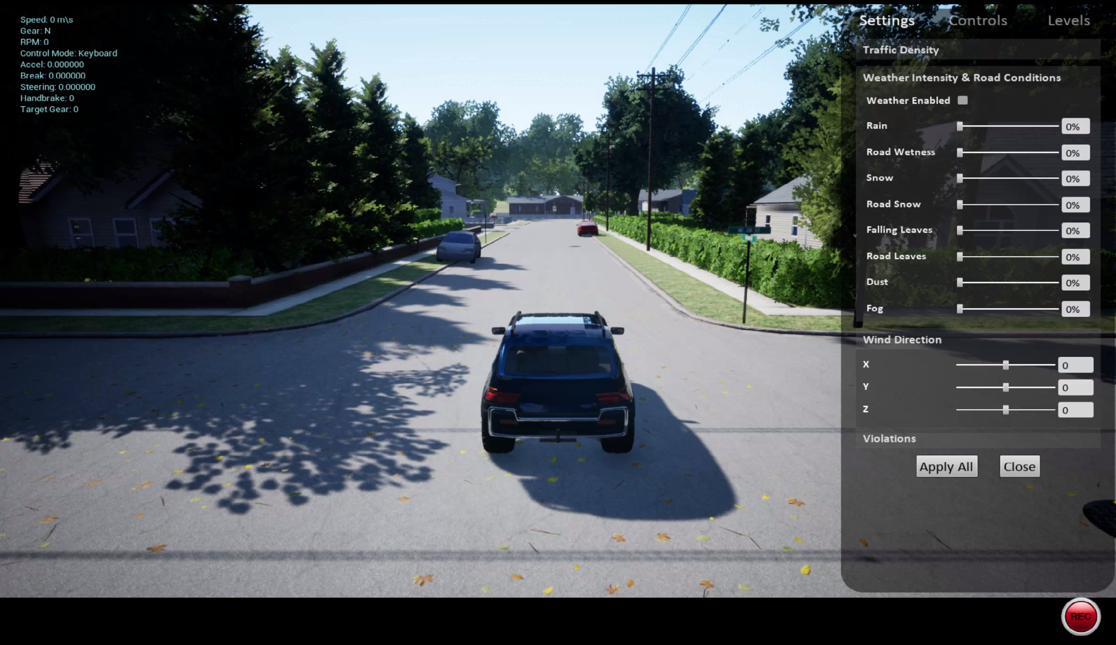
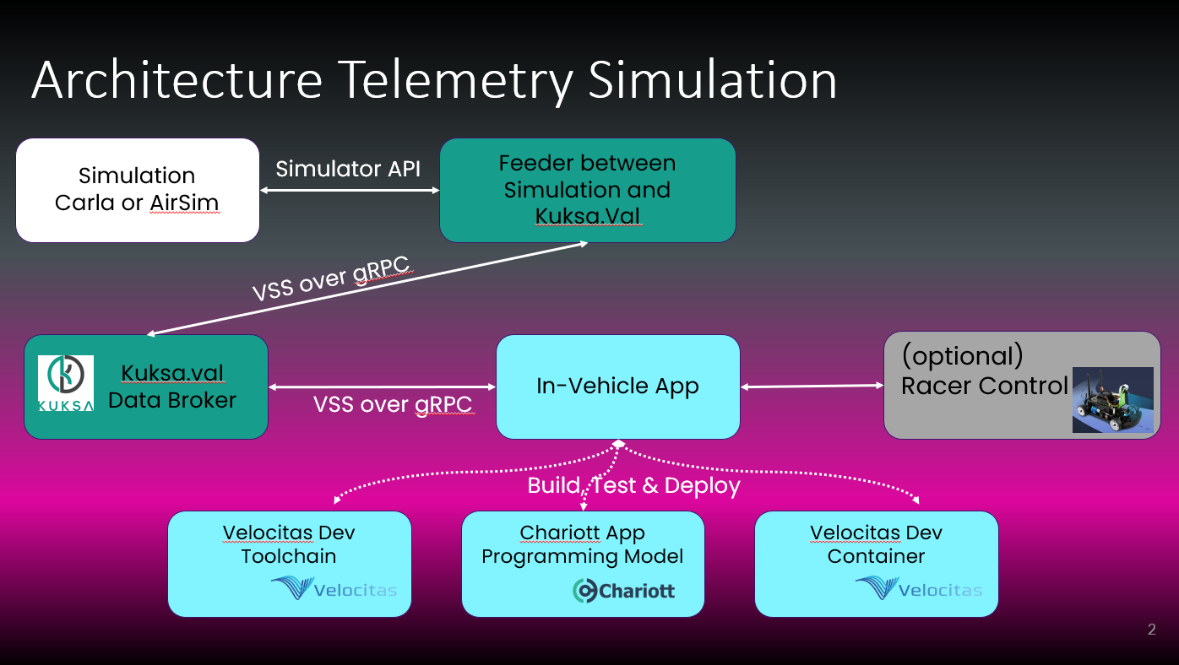
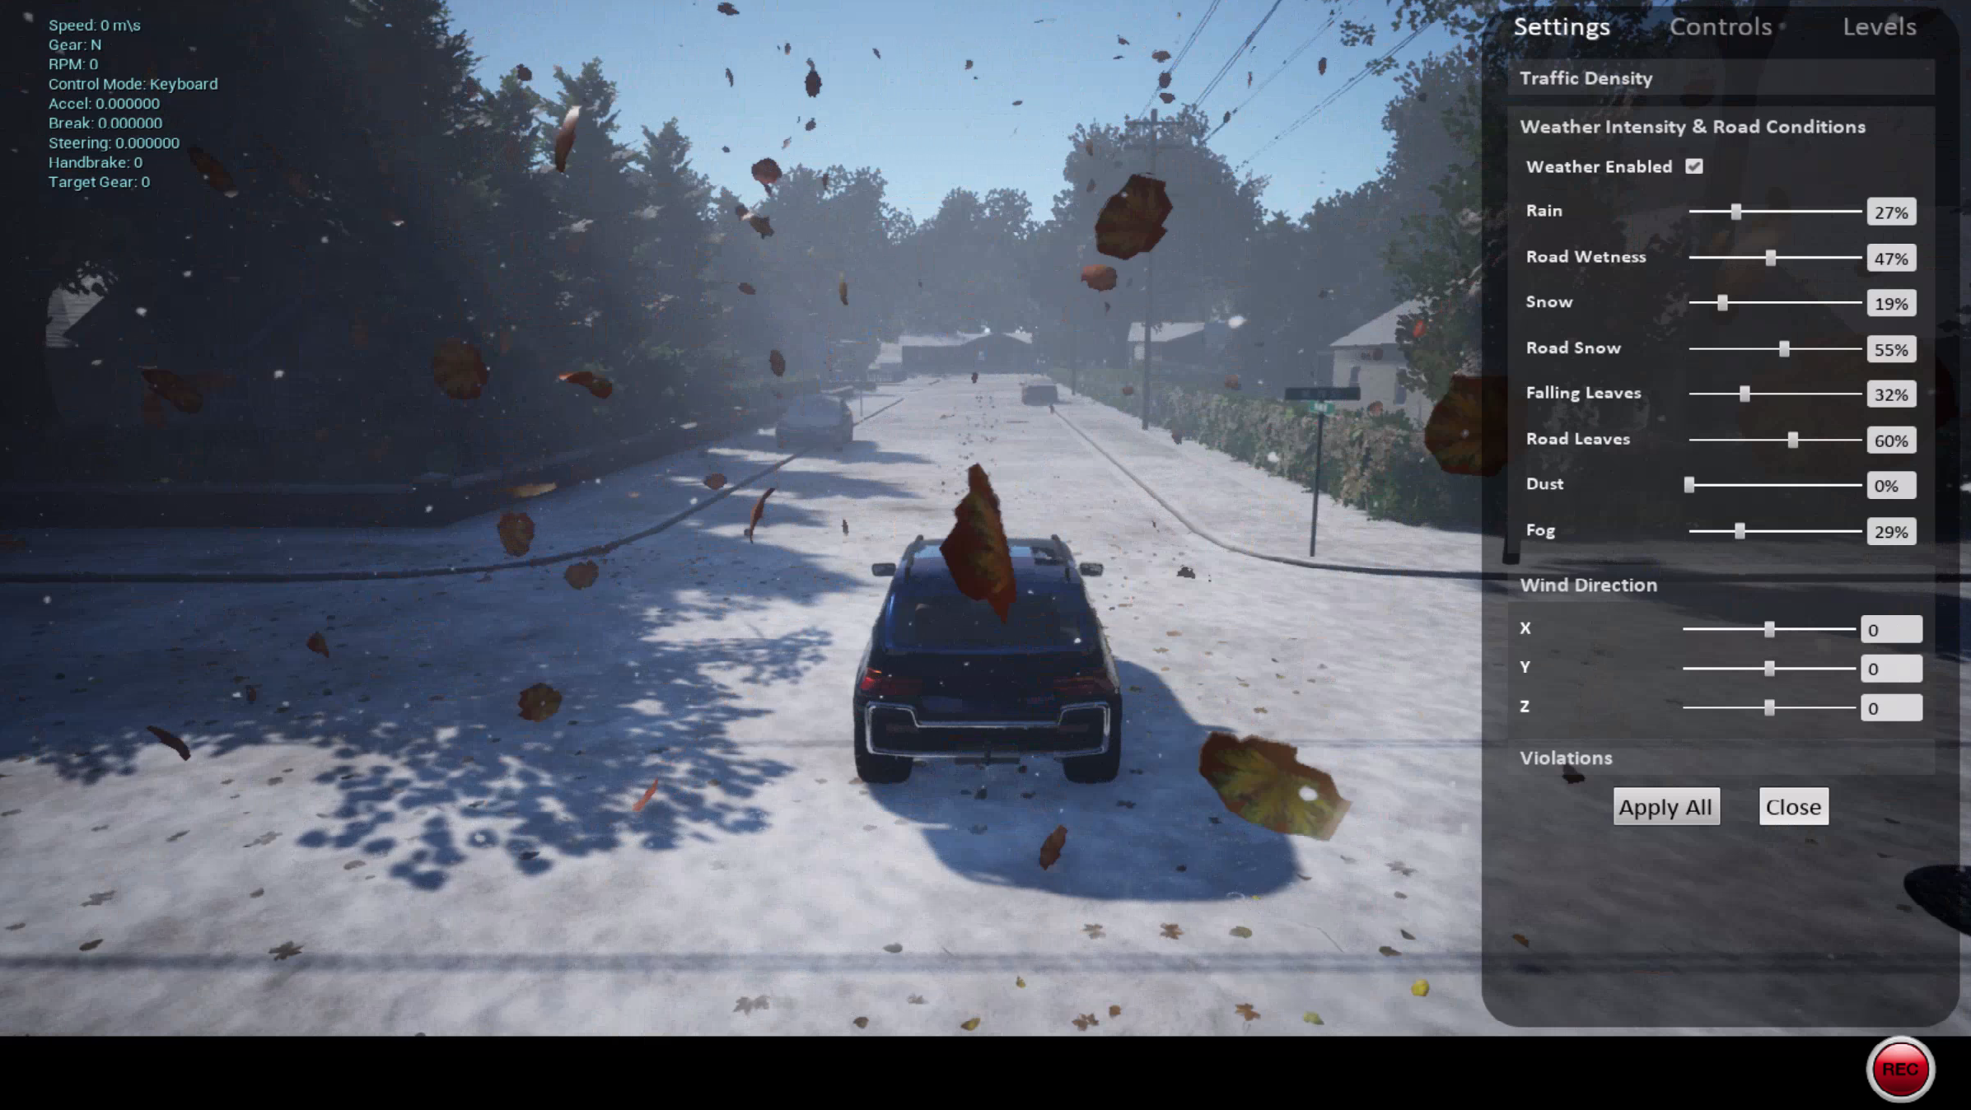


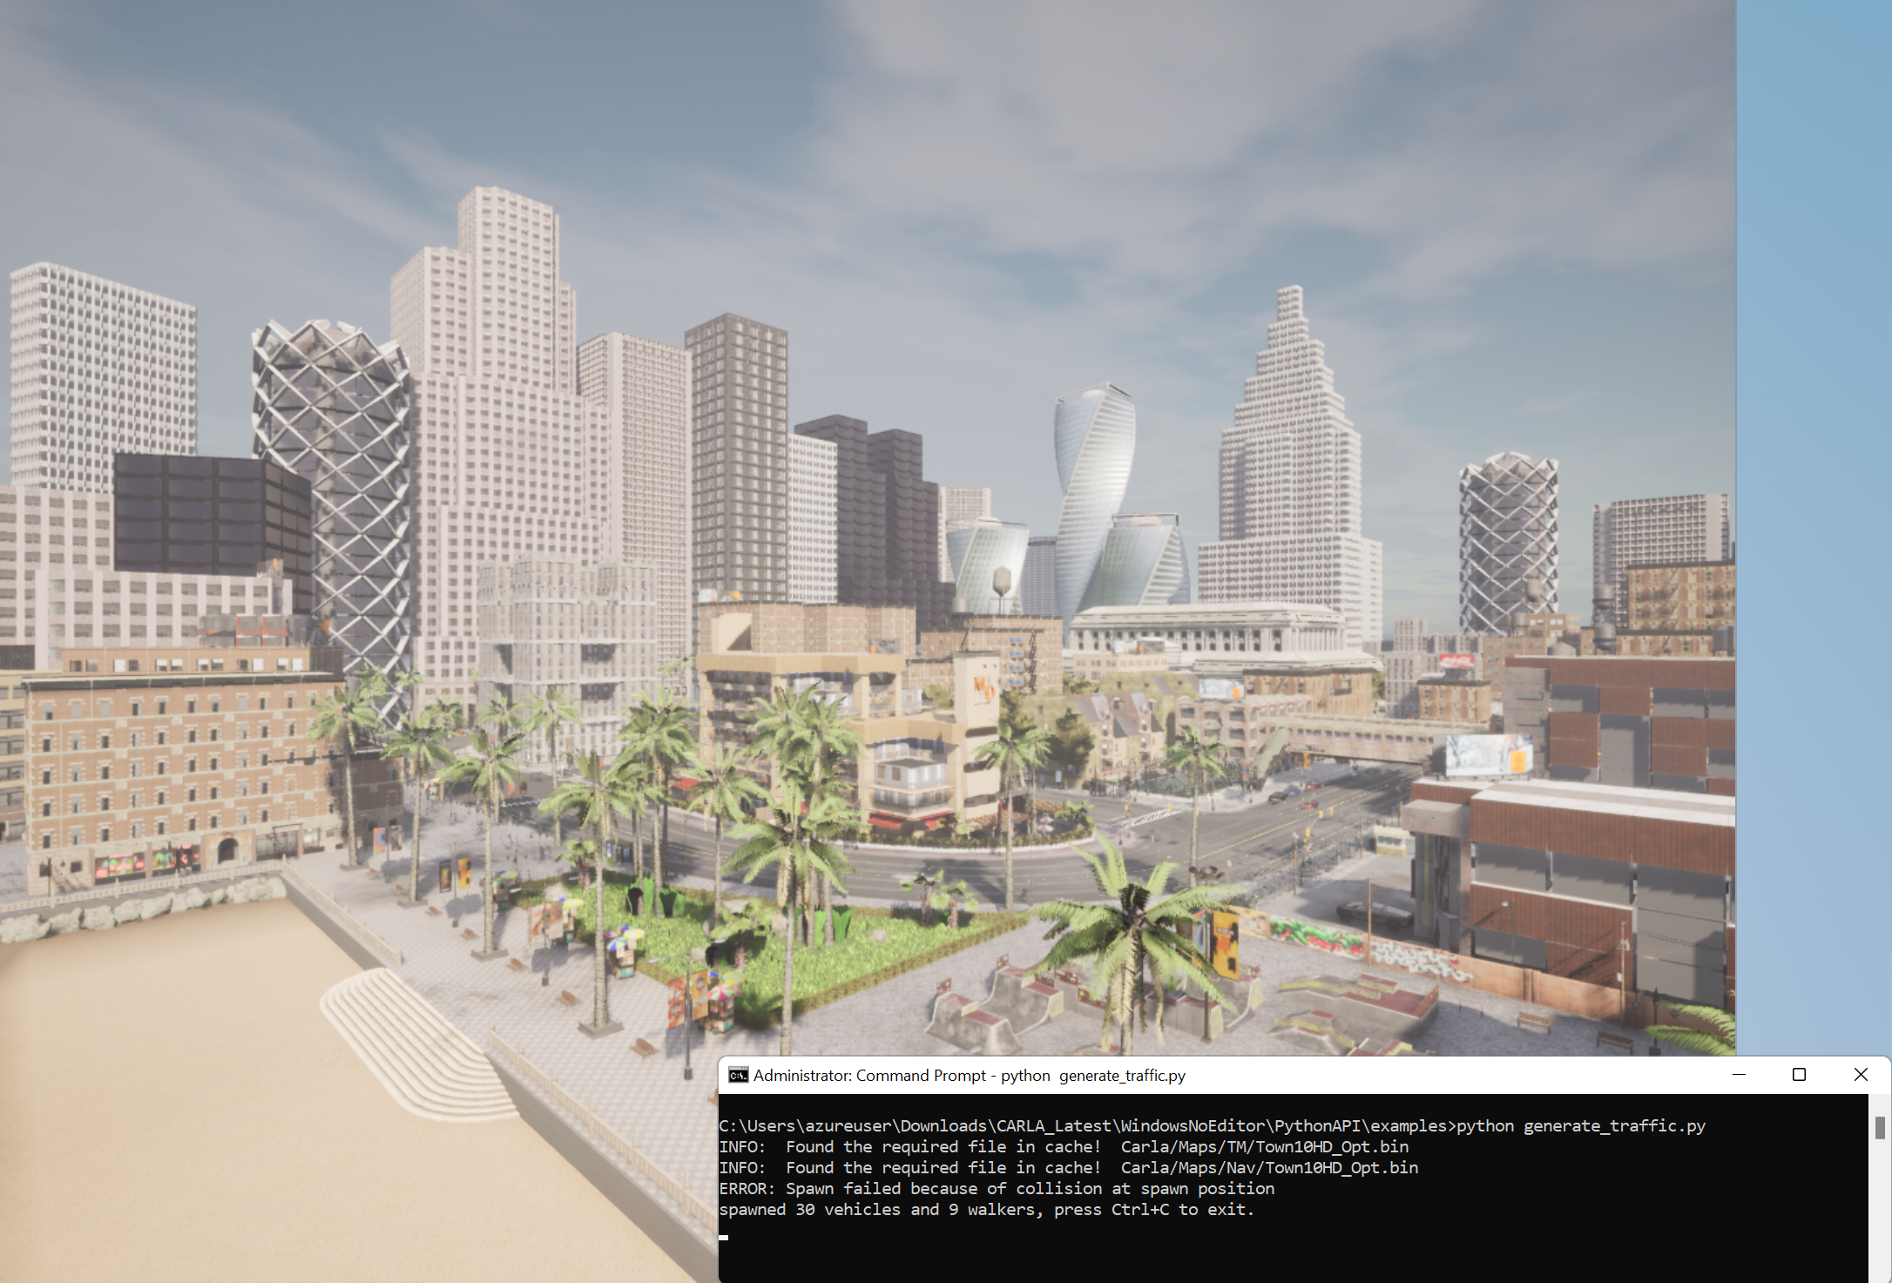

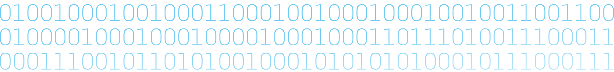

{hackathon}
{Hackathon}
Virtual Vehicle Application
BCX Challenge 1
Goal of the challenge:
Leveraged virtualized environments to generate vehicle telemetry data and use it to integrate with software-defined vehicle frameworks to build next-generation in-vehicle applications.
Data source & actuators:
Simulation Tooling
Carla: CARLA Simulator
Airsim: https://github.com/microsoft/AirSim
Device (optional)
PiRacer (based on Jetson Nano)
Example hacks:
Physical to Virtual test of In-Vehicle functions
Virtual to Physical In-Vehicle Gaming
Example architecture:
Projects involved:
Chariott: Application Programming Model
Kuksa: Data Feed Broker
Velocitas: Development Toolchain for containerized in-vehicle applications

